Slide 1
Digital portfolio Front-END web development
NAME : VASANTHAKUMAR. S
NM ID : 𝐚𝐬𝐚𝐧𝐦10824131081802521078
Reg no : 24131081802521078
Department : computer science
College : Thiru kolanjiappar government arts college
University: ANNAMALAI UNIVERSITY

Slide 2
Problem statement
In the present digital world, personal branding and professional visibility have become extremely important. Traditional resumes and CVs often fail to demonstrate a developer’s real skills in building modern, interactive, and user-friendly interfaces. Recruiters and clients are more likely to be impressed when they can actually see the work live instead of just reading about it.The lack of a professional digital portfolio makes it difficult for aspiring developers, freelancers, and job seekers to differentiate themselves in a competitive environment. Therefore, there is a strong need for a well-structured, visually appealing, and technically sound digital portfolio that highlights not just academic qualifications, but also real skills, projects, and creativity.This project attempts to address that gap by creating a responsive digital portfolio website with an elegant multi-colour navigation bar, interactive highlights, project showcases, skills representation, and a contact form — all developed using HTML, CSS, and JavaScript.

Slide 3
Project overview
The Digital Portfolio – Front-end Web Development project is designed to act as a personal website that introduces the developer, outlines technical strengths, and displays sample projects.The project makes use of modern design principles such as:Consistency: A cohesive colour palette with dark background and neon highlights.Readability: Clean typography using the Google “Inter” font.Responsiveness: Ensuring the layout adapts seamlessly to different devices.Interactivity: Smooth scrolling, active navigation highlights, and simple animations.Accessibility: Semantic HTML, descriptive labels, and keyboard-friendly interactions.Overall, this project is more than just a website — it is a professional identity in digital form.

Slide 4
End users
This portfolio is intended to serve multiple categories of end users:
1. Recruiters and Hiring ManagersThey can quickly browse through the candidate’s skills, projects, and contact details.The portfolio reflects professionalism and technical ability.
2. Freelance ClientsClients searching for front-end developers can review past projects and areas of expertise.The neat and interactive design assures them of quality work.
3. Peers and CollaboratorsOther developers can use the portfolio as a point of reference for collaborations or knowledge sharing.
4. Personal Branding AudienceFriends, mentors, and academic professionals can review the portfolio to assess growth and provide feedback.

Slide 5
Tools and Technologies
The following tools and technologies were used in building the portfolio:
HTML5 → For structuring the content with semantic elements.
CSS3 → For styling, layout, gradients, animations, and responsiveness (Flexbox & Grid).
JavaScript (Vanilla) → For interactivity, smooth scrolling, active link highlighting, and form handling.
Google Fonts (Inter) → For modern and professional
.VS Code → Code editor with live server extensions
Git & GitHub → Version control and repository hosting.

Slide 6
Portfolio Design and Layout
The design is inspired by minimalistic, modern web design trends, while still offering visual creativity through gradients and animated navigation.Navigation BarSticky at the top with a moving rainbow gradient strip.Includes smooth scroll and active link indicator.Hero SectionProminent introduction headline with personal name and role.A sub-text providing a short description of expertise.A highlighted info panel showing availability, email, and location.Highlights SectionInteractive badges that summarize technical strengths (HTML, CSS, JS, accessibility, responsive design, animations).Centrally aligned to grab attention immediately.Projects SectionGrid of tiles displaying project titles and descriptions.Focused on demonstrating both technical and design capabilities.Skills SectionWell-categorized into languages, frameworks, tools, and soft skills.Each skill is placed in a tile for quick readability.Contact SectionContact form (demo) with fields for name, email, and message.Email link included for direct communication.FooterDisplays copyright with dynamic year update via JavaScript.

Slide 7
Features and Functionality
The portfolio offers multiple functional and design-oriented features:
1. Multi-colour Animated Navigation BarEnhances first impression and guides navigation visually.
2. Smooth Scroll with Scroll-SpyEnsures users can easily jump to sections.Automatically highlights active section in navbar.
3. Responsive DesignGrid and flexbox make the layout adapt to mobile, tablet, and desktop screens.
4. Accessibility EnhancementsSemantic elements, aria labels, and focus handling improve usability.
5. Projects & Skills ShowcaseHighlights technical expertise through categorized tiles and examples.
6. Contact FormProvides an interactive way to reach out.Includes local demo handling for form submissions.
7. Dynamic Year in FooterAuto updates every year via JavaScript, keeping the site evergreen.

Slide 8
Results and Screenshots
The outcome of the project is a functional and aesthetic portfolio website that reflects the developer’s capabilities.Key results include:Fully responsive design across devices.Professional presentation of projects and skills.Enhanced user experience with smooth navigation and animated highlights.Organized layout that is easy to understand for recruiters and clients

Slide 9
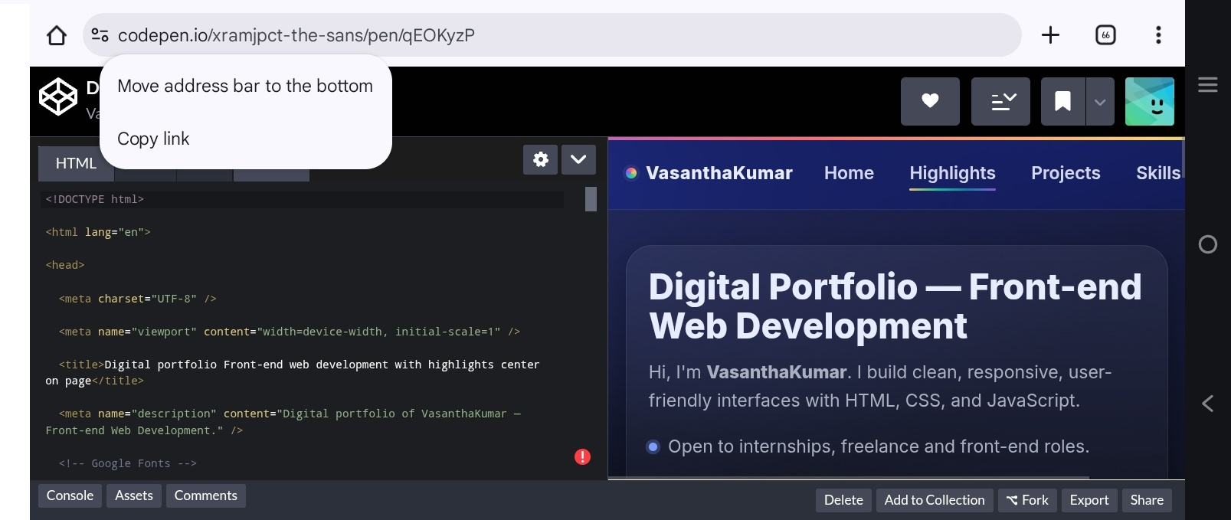

Slide 10
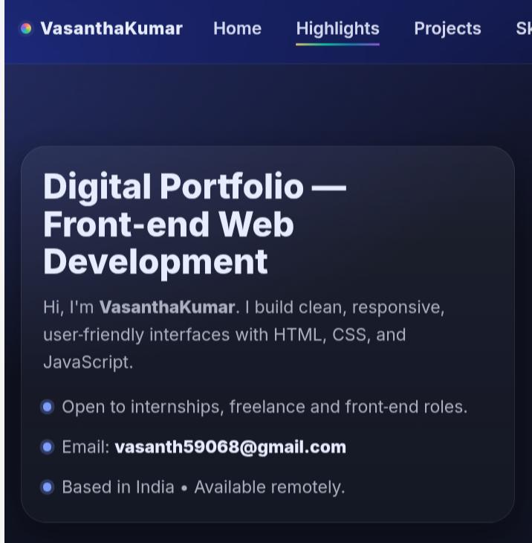

Slide 11
Conclusion
This project demonstrates how a front-end developer can leverage core web technologies (HTML, CSS, and JavaScript) to create a professional digital presence.The portfolio successfully solves the problem of personal branding by providing:A central platform to showcase skills and projects.A modern, mobile-friendly design that reflects industry standards.Easy navigation and interactivity to keep users engaged.Future enhancements could include:Connecting the contact form to a backend or third-party service.Adding live project links and GitHub integration.Expanding sections for blogs, certifications, and testimonials.Deploying the site on platforms like Netlify, Vercel, or GitHub Pages.

Slide 12
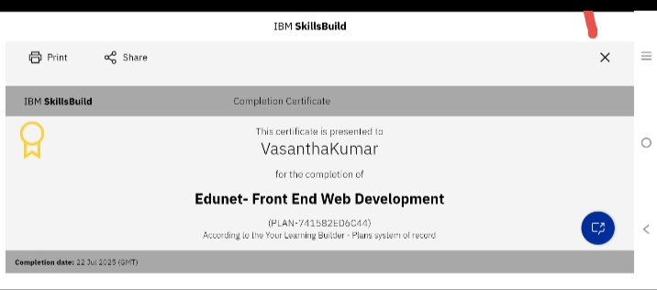

Slide 13
THANK YOU

